Slide 1
UNIT – 5

Slide 2
NEW IT INITIATIVES

Slide 3


Slide 4
INTRODUCTION
Definition of Enterprise Resource Planning:
Enterprise Resource Planning (ERP) is a information system solution that integrates various functional departments, management hierarchies and locations.
ERP connects all the functional departments into a single system. Earlier ERP system were used in only large industrial organizations. Today, ERP can be applied to any type of company irrespective of any field.

Slide 5
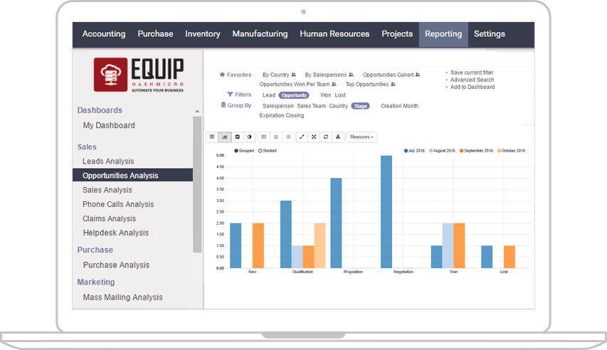
WHY IS ERP IMPORTANT FOR YOUR BUSINESS?

Slide 6
Optimizing Efficiency
Increasing Team Collaboration
Reducing Operating Costs
Improving Data Security
Making Realistic, Accurate Forecasts

Slide 7
HOW TO DECIDE WHEN YOUR BUSINESS NEEDS ERP?
Your staff spend too much time on tasks that shouldn’t be done manually
You don’t have quick and easy access to the data you need to make business decisions
Your business work with various vendors or suppliers across different regions or countries
You have many different applications that you have implemented for your business over the years, but they are not connected to each other
You are unable to monitor your inventory level every day

Slide 8
Needs too much time for searching information, trying to increase productivity and efficiency, and integrate various functions in your business
Your staff can’t easily collaborate or share information with each other
You can’t access important business data and information when you are outside the office
You address problems when it’s too late; in other words, you can’t be proactive when it comes to identifying problems in your business process

Slide 9
ROLE OF INFORMATION MANAGEMENT IN ERP
According to Askenas, there are five roles of information management in ERP:
Manipulator: A manipulator is someone who controls, directs or influences others in a way that is not entirely of their choosing. The ERP system play the role of manipulator.
Bureaucrat: A bureaucrat is an official who adheres strictly to the rules and principles laid down for him, rather than making individual considerations. An ERP system given the role of a bureaucrat maintains the structure in the organisation.

Slide 10
Administrative Assistant: An administrative assistant is someone who takes care of less complicated tasks in an orderly way. An ERP system given the role of an administrative assistant for record keeping and dissemination of data.
Consultant: An ERP system acting as a consultant provides the user with options and with solutions tailored to the situation.
Dismissed: The ERP that is dismissed becomes redundant (unnecessary). There may be many reasons for this but, to keep dismissing the system, the user will need good reasons

Slide 11
E-BUSINESS
What is E-Business?
E-Business (e-Business), or Electronic Business, is the administration of conducting business through the Internet. This would include the buying and selling of goods and services, along with providing technical or customer support through the Internet.
Advantages of E-Business:
Increased Profits
More Satisfied Customers
Better Supplier Relationship

Slide 12
WHAT ARE THE BENEFITS OF E-COMMERCE OVER TRADITIONAL COMMERCE OR RETAIL?
No geographical limitation
Easy way to gain customer by search engine visibility
Lower cost/investment
Locate product quickly
Save travel time and cost
Enables deal, bargain, coupons and group buying
Abundance of information
Remains open all the time
Create an e-commerce store for niche products
Creates targeted communication

Slide 13
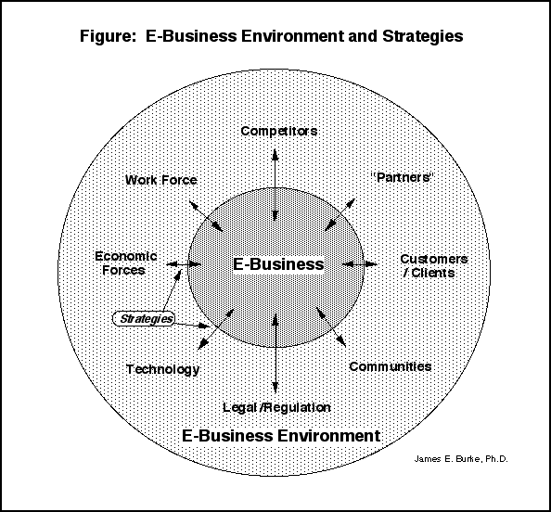
E-Business Environment:

Slide 14
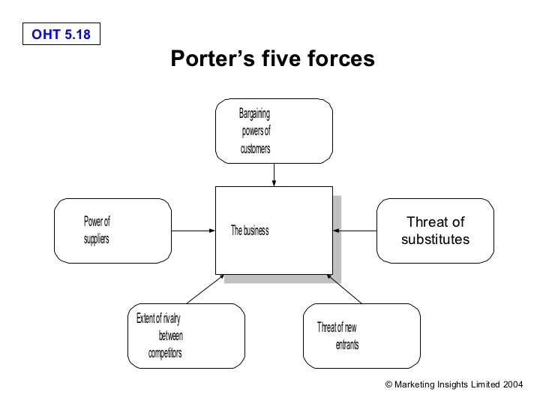
Threats to E-Business:

Slide 15
E-GOVERNANCE
Definition of E-Governance:
E-Governance is process in which Government work, share information and deliver services through internet to external and internal clients for the benefit of both government and clients.
In short, E-Governance means all activities which are carried out by the government electronically, that is through the internet.

Slide 16
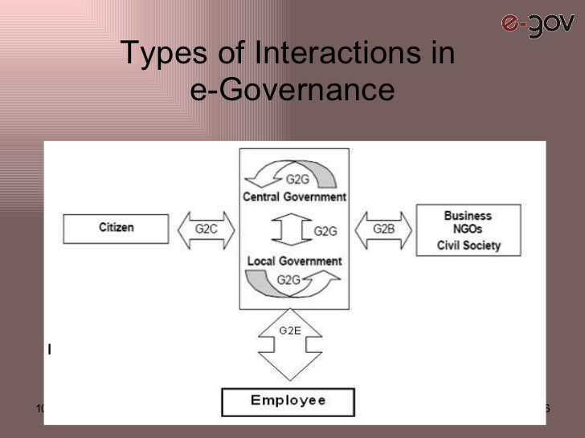
Types of Interactions in E-Governance:

Slide 17
G2G (Government to Government): Online interactions between two government departments and government organizations.
G2C (Government to Citizens): Government providing service to citizens through internet. Example: Railway, Electricity Board, etc.
G2B (Government to Business): Online commercial interaction between government and business sectors. Example: L&T, Ashok Leyland, Reliance, etc.
G2E (Government to Employees): Imposing rules and regulations to employees through online, issuing orders and allotting work through online.

Slide 18
DATA MINING
What is Data Mining?
Data Mining is the process of getting hidden information from the database for analysis purpose. In short, data mining is extraction of data from a large database for some specialized work.
Data Mining is the process of analyzing data from different perspectives and summarizing it into useful information.

Slide 19
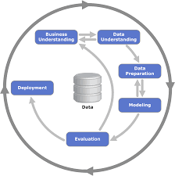
Data Mining Process:

Slide 20
Data Mining Process:
Problem Definition/Business Understanding: This is the first step in which the problem is identified and then setting objectives to reach target.
Data Exploration/Data Understanding: In this stage, the data mining explains the data which is accurate and then it is implemented in the business.
Data Preparation: Preparing or organising the data in usable form by using tables, charts, etc.
Modelling: In this phase, the stored data is frequently exchanged between experts.

Slide 21
Evaluation: This stage involves evaluating the database to find out whether the data is sufficient and meeting the business requirements and needs.
Deployment: This is the last stage in data mining process, in which converting or copying the database and protecting the database from unauthorized access is done. The main aim of deployment phase is to protect the database from unauthorized access.

Slide 22
TOP 10 DATA MINING TOOLS
Rapid Miner.
Oracle Data Mining.
IBM SPSS Modeler.
Knime.
Python.
Orange.
Kaggle.
Rattle.
Weka
Teradata

Slide 23
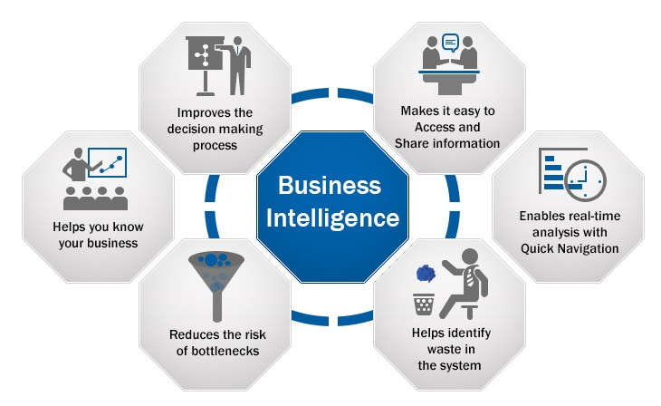

Slide 24
BUSINESS INTELLIGENCE
What is Business Intelligence?
Business Intelligence (BI) is the new technology for understanding the past and predicting the future. This is a broad category of technologies that allows for gathering , storing, accessing and analysing data to help business users make better decisions.
Activities of Business Intelligence:
Decision support system
Query and reporting
Online Analytical Processing (OLAP)
Statistical analysis, forecasting and data mining.

Slide 25
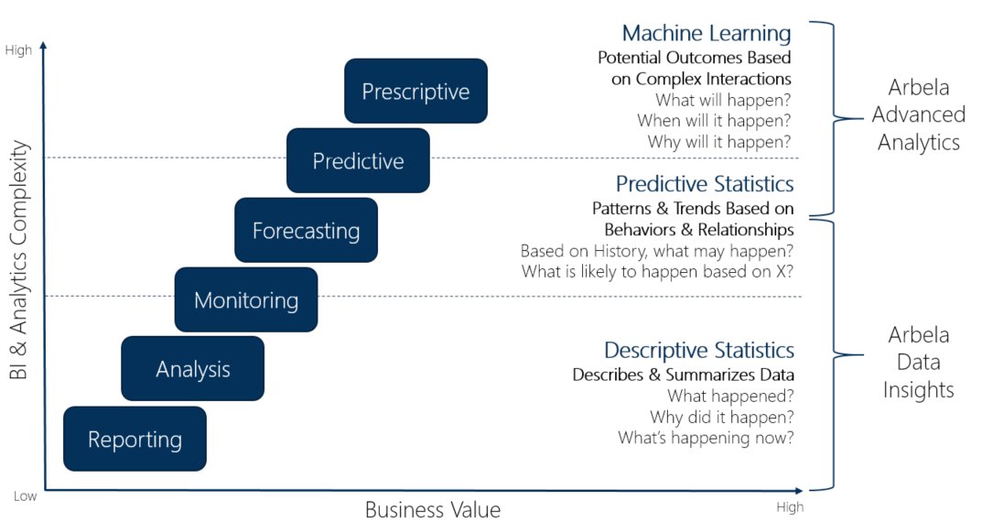
BUSINESS INTELLIGENCE MODEL

Slide 26
PERVASIVE COMPUTING
What is Pervasive Computing?
Pervasive computing is an emerging trend associated with embedding microprocessors in day-to-day objects, allowing them to communicate information. It is also known as ubiquitous computing. The terms ubiquitous and pervasive signify "existing everywhere." Pervasive computing systems are totally connected and consistently available.
A combination of technologies is used to make pervasive computing possible, such as Internet capabilities, voice recognition, networking, artificial intelligence and wireless computing.

Slide 27
AREAS OF APPLICATION OF PERVASIVE COMPUTING
Retail.
Airlines booking and check-in.
Sales force automation.
Healthcare.
Tracking.
Car information System.
Email access via WAP (Wireless Application Protocol) and voice.

Slide 28
CLOUD COMPUTING
Definition of Cloud Computing:
In cloud computing, the word cloud is used as a metaphor for "the Internet," so the phrase cloud computing means "a type of Internet-based computing," where different services such as servers, storage and applications are delivered to an organization's computers and devices through the Internet.
Cloud Computing provides businesses and consumers with access to software, data storage, etc.

Slide 29
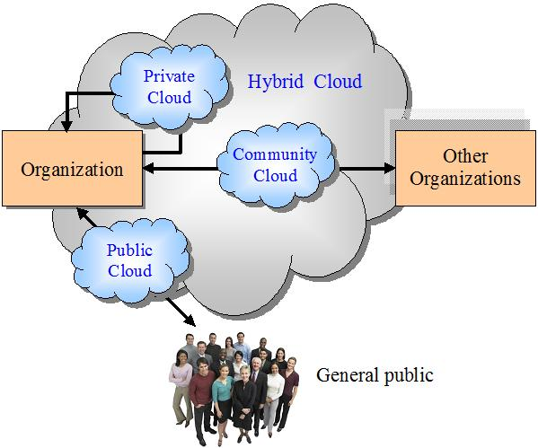
Cloud Computing Models:

Slide 30
CLOUD COMPUTING MODELS
Private Cloud: The private cloud is maintained and operated for a specific organization. The operation may be in-house of the business.
Community Cloud: This cloud infrastructure is shared among a number of organizations with similar interests and requirements.
Public Cloud: The cloud is available to public on a commercial basis by the service provider. Here the public can access data of a business concern.
Hybrid Cloud: It is a mixture of number of clouds which has the ability to move data or applications from one cloud to another

Slide 31
CAPABILITY MATURITY MODEL (CMM)
What is Capability Maturity Model (CMM)?
Capability Maturity Model is a bench-mark for measuring the maturity of an organization’s software process. It is a methodology used to develop and refine an organization’s software process. It describes the maturity of the software based upon the project the company is dealing with the clients.

Slide 32
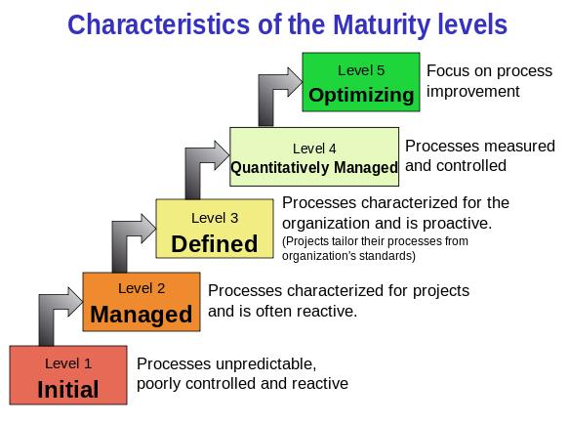
MATURITY LEVELS OF CMM

Slide 33
Maturity Level 1 – Initial: Company has no standard process for software development. Nor does it have a project-tracking system that enables developers to predict costs or finish dates with any accuracy.
Maturity Level 2 – Managed: Company has installed basic software management processes and controls. But there is no consistency or coordination among different groups.
Maturity Level 3 – Defined: Company has pulled together a standard set of processes and controls for the entire organization so that developers can move between projects more easily and customers can begin to get consistency from different groups.

Slide 34
Maturity Level 4 – Quantitatively Managed: In addition to implementing standard processes, company has installed systems to measure the quality of those processes across all projects.
Maturity Level 5 – Optimizing: Company has accomplished all of the above and can now begin to see patterns in performance over time, so it can tweak its processes in order to improve productivity and reduce defects in software development across the entire organization.

Slide 35
The End

Slide 36
Thank You

